Slide 1
THESIS –TITLE (Tentative) SMART AIR POLLUTION PREDICTION SYSTEM

Slide 2
NAME:- R.UDAYA BHARATHI,
GUIDE:- Dr . M.SESHASHAYEE
Reg No:- 1263715404
DEPT:- COMPUTER SCIENCE ,
DATE OF JOINING : OCTOBER ,2015.
YEARS COMPLETED: 5 YEARS COMPLETED

Slide 3
LIST OF OBJECTIVES
LIST OF OBJECTIVES: 1. AIR POLLUTION DETECTION
2. AIR POLLUTOIN PREDICTION
3. SEQUENTIAL MODELLING OF AIR POLLUTION DATA
NO: OF OBJECTIVES: 2 OBJECTIVES COMPLETED
COMPLETED
NO: OF OBJECTIVES
TO BE COMPLETED : 1 TO BE COMPLETED

Slide 4
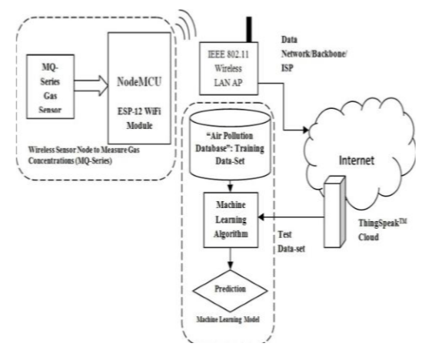
RESEARCH METHODOLOGY
AIR POLLUTION PREDICTION SYSTEM USING IOT

Slide 5
AQI Data

Slide 6
Air Pollution Prediction using Lstm
Forecasting the air pollution using Air quality Index data which is collected from Delhi , five months of data is used for training data set and one month is used for test data.
Building a function of LSTM model using sequential model, the data is predicted.

Slide 7
LIST OF PUBLICATIONS
S no | TITLE | Publication | Category
1. | Internet of Things Trends and surprises | IJSRST | UGC
2. | Weather and Air pollution real time monitoring system using Internet of Things | IJITEE | UGC
3. | Intelligent Air Pollution Prediction system using Internet of Things | IJEAT | Scopus

Slide 8
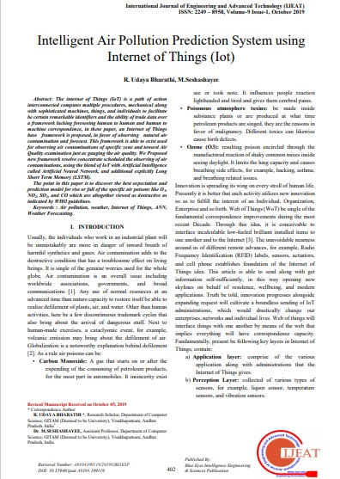
JOURNALS PUBLISHED IN RESEARCH

Slide 9
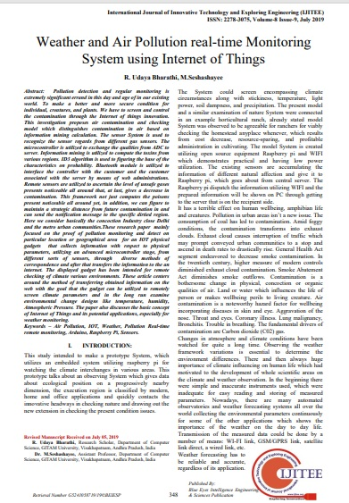

Slide 10
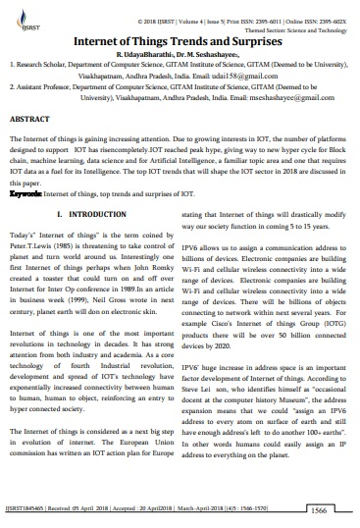

Slide 11
THANK YOU

